Slide 1

Module 7.5
IoT Interaction Protocols
Part I
B8019 - PROGRAMMING THE INTERNET OF THINGS M
Academic Year 2026/2027
Second cycle degree programme (LM) in Computer Engineering (cod. 5826)
Prof. Abdelsalam Helal
© 2020-2026 Sumi Helal

Slide 2
Lecture Overview
Assessing the Value of an IoT
IoT Meaningful Interactions
RESTful API
CoAP
MQTT
6LoWPAN
IoT Device Management (OMA-DM and LwM2M)

Slide 3
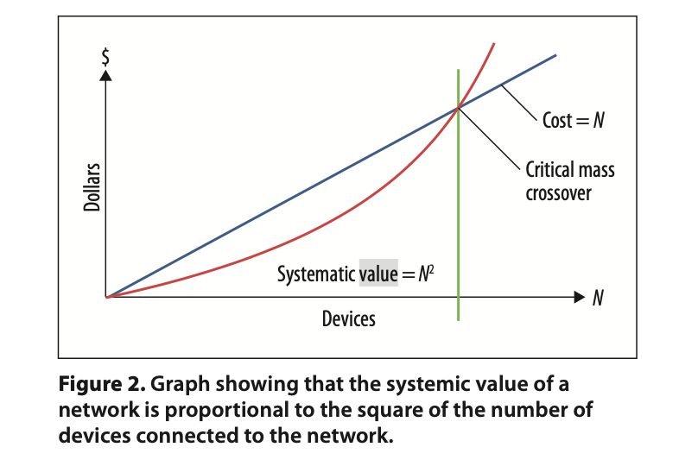
The Value of any Network
Metcalfe’s Law, over 47 years ago:
  V ≈ N*(N-1)
Andrew Odlyzko and Benjamin Tilley:
  V ≈ N*ln(N) ➔ not all network connections are of equal values!
Metcalfe’s Self-Adjusted Law – 8 years ago:
  V ≈ revenue generating customers over time. Use of netoid and sigmoid* based simulation. ➔ The capture of social media added value (based on Facebook data)
* Sigmoid and Netoid are closely related mathematical functions
used to model growth, particularly technology adoption and network growth.

Slide 4

The Value of an IoT
P = estimate of the number of ways in which a particular IoT can participate (be programmed) into different applications (size of the application space)
E = estimate of the effort that must be put forth to enable the development of the application space.
  E ranges from ∞ (traditional system integration) to e - a small number (autonomic/self integration)
  Consider: Isolated vs advertised IoT, open programmatic interface vs closed one, etc.
  Consider: Powerful programming models vs weak or no programming models.
  The Value of an IoT is highly influenced by the IoT Programming Model especially with regards to architectural elements that enables autonomic/self-integration

Slide 5
IoT Meaningful Interactions
Interactions between the IoT things are the essence (blueprints) of the IoT applications. Hence IoT interaction protocols must convey more than bits of data – They execute a good part of the application logic and semantics!
In other words, the application is achieved through meaningful interactions guided by these protocols. Interactions are therefore expected to be:
  Indicative of interest, revealing of resources and capabilities
  Explanative of the semantics behind the interaction (Why interact)
  Instructive of means (How to interact back)
Ideally, protocols should be light-weight and inexpensive
Towards this end: we will examine: RESTful, CoAP, MQTT, among others.

Slide 6
RESTful
Representational State Transfer

Slide 7
REpresentational State Transfer*
Software architecture principle (design pattern) allows creating scalable web services in terms of system's resources (e.g., how resource states are addressed and transferred by a wide range of clients in different languages).
Uses URI addressable resources. Client request is mapped into the URI. The addressable resource provides the response – a “transferred state, based on a specific representation as desired by the client”
RESTful systems use a simple, constrained interface to interact: the Hypertext Transfer Protocol with the same HTTP verbs (GET, POST, PUT, DELETE, etc.) used by web browsers to retrieve/send data to remote servers.
* Thomas Fielding PhD Dissertation at UC Irvine (2000): Architectural Styles and the Design of Network-based Software Architectures

Slide 8
REpresentational State Transfer
A REST Web service follows four basic design principles:
Use HTTP methods explicitly, as a simple interface to web services.
Stay stateless.
Expose “directory structure”-like (tree) of URIs.
Transfer different representations of the state: HTML for Web browsers, JSON (e.g., for JavaScript), and XML (e.g., for Java apps).

Slide 9
A Simple Web Service as an Example
Querying a phonebook application for the details of a given user.
Using SOAP Web Services:
The request would look something like this:
<?xml version="1.0"?>
<soap:Envelope
xmlns:soap="http://www.w3.org/2001/12/soap-envelope"
soap:encodingStyle="http://www.w3.org/2001/12/soap-encoding">
<soap:body pb="http://www.acme.com/phonebook">
<pb:GetUserDetails>
<pb:UserID>12345</pb:UserID>
</pb:GetUserDetails>
</soap:Body>
</soap:Envelope>
Using REST?
The query will look like this one liner:
http://www.acme.com/phonebook/UserDetails/12345

Slide 10
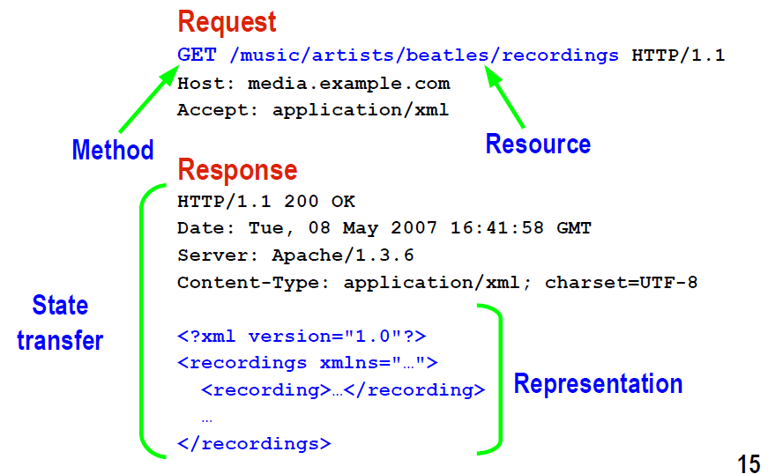
REST Request/Response

Slide 11
RESTful IoT
REST has gained acceptance across the Web as a simpler alternative to SOAP (Simple Object Access Protocol) and WSDL (Web Services Description Language).
In IoT world: RESTful has been adopted as a highly popular, simple-to-use, and lightweight interaction method (Lab 2!)
RESTful supports Meaningful Interactions:
  Carefully named “directory structure”-like resources convey more meaningful interactions than an IP packet sent to an IP address.
But, of course, there are limitations!
  Does not easily support binary encoded messages
  Support IP only through the relatively expensive and heavy TCP.
  Lack of P2P support. Only Client-Server interaction, no inter IoT communication
  Lack of multicast capabilities
  Lack of streaming-type communication – supports only PULL mode, no PUSH allowed.

Slide 12
RESTful IoT
References
https://en.wikipedia.org/wiki/Representational_state_transfer
http://www.ibm.com/developerworks/library/ws-restful/
http://www.ics.uci.edu/~fielding/pubs/dissertation/fielding_dissertation.pdf

Slide 13
CoAP
Constrained Application Protocol

Slide 14
Constrained Application Protocol
A specialized IETF application-level, web transfer protocol for use with constrained devices and constrained networks in the Internet of Things.
Supports REST & at the same time overcomes some of REST’s limitations:
  Encoding (text) scheme and message size: supports binary encoding
  Transport: based on UDP (port 5683, 5684 for secure CoAP on top of DTLS*) – even though support for TCP was added in 2018 as an option (RFC 8323)
  Lack of P2P support: support for Serverless M2M operation through resource discovery and publish/subscribe paradigms.
  Lack of multicast: support for multicast
  Lack of streaming-type communication: support push mode through subscribe/notify
DTLS: Datagram Transport Layer Security

Slide 15
Constrained Application Protocol
Based on the widely successful REST model, CoAP “servers” make resources available under a URL, and CoAP clients access these resources using HTTP methods: GET, PUT, POST, and DELETE.
CoAP can carry different types of payloads and can identify which payload type is being used. CoAP integrates with HTML, XML, JSON, on the one hand, and with CBOR¹ and other concise binary encoding on the other hand.
Highly secure. CoAP's default security choice of DTLS² parameters is equivalent to 3072-bit RSA keys.
¹ Concise Binary Object Representation
² Datagram Transport Layer Security

Slide 16
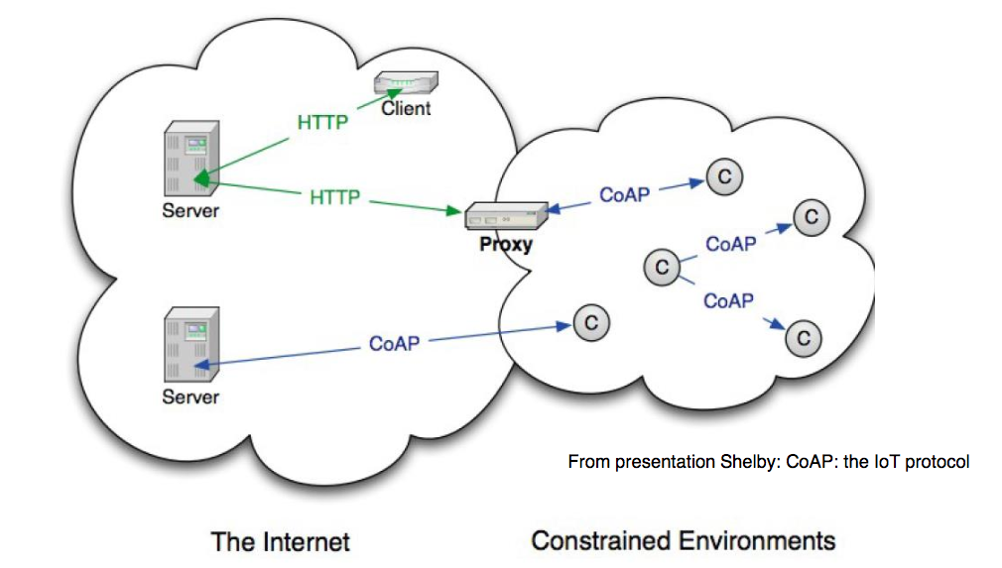
End-to-End REST Operation in CoAP
Each CoAP thing is both a client and a server.
This means a CoAP device can directly interact with another CoAP device – no need for an HTTP server.
CoAP seamlessly integrates with HTTP, however, through a proxy.
Dedicated CoAp servers can be deployed and used on the Internet

Slide 17
More Features of the CoAP Protocol
Resource advertisement and discovery mechanisms:
  Servers multicast a list of their resources (along with metadata about them). Why this is a major advantage over RESTful services?
Powerful PUSH-type I/O:
  CoAP extends the HTTP request model with the ability to observe a resource, this allows servers to stream state changes to clients as they occur.
References:
http://coap.technology/
http://www.eclipse.org/community/eclipse_newsletter/2014/february/article2.php
A good presentation by Johan Lukkien, TU: http://www.win.tue.nl/~johanl/educ/2IMN15/IoT-08-CoAP.pdf

Slide 18
MQTT
Message Queuing Telemetry Transport

Slide 19

Message Queuing Telemetry
Transport (MQTT)
Why MQTT:
Sometimes, we know what we want and where we might find it (REST)
Yet, sometimes, we may know what we want, but do not know (or do not want to know where to get it from) (MQTT).
  I am interested in learning about the weather but do not care who provide the weather information.
Also, sometimes we do not care to tell the world about ourselves (REST), yet sometimes, it is crucial to let everybody knows (MQTT & CoAP).
  Example: A sensor publishes temperature readings — it doesn't need to know which dashboard is subscribing (MQTT)

Slide 20
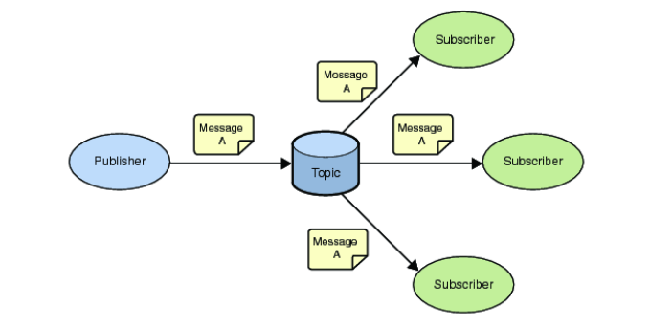
MQTT - Message Queuing Telemetry Transport
Old Concept of Message Queues brought to IoT World
A light-weight event and message-oriented protocol allowing devices to asynchronously communicate efficiently across constrained networks to remote systems
Publishers publish messages on a topic.
Subscribers subscribe to messages about a topic.
Broker is used to match sub/pub and to deliver messages in case of matches.

Slide 21
MQTT Topic Address Space
A topic forms the namespace which is hierarchical with each “sub-topic” separated by a /
An example topic space for a smart house:
  Published Topics:
    <country>/<region>/<town>/<postcode>/<house>/energyConsumption
    <country>/<region>/<town>/<postcode>/<house>/solarEnergy
    <country>/<region>/<town>/<postcode>/<house>/alarmState
  Subscribed Topic:
    <country>/<region>/<town>/<postcode>/<house>/thermostat/setTemp
Wildcards can be used (+ and #).

Slide 22
A More Detailed Smart House Example

Slide 23
MQTT Topic Names vs. Subscription Filters
A publisher specifies one exact topic name; subscribers register filters that determine what they receive.
SUBSCRIPTION TOPIC FILTER
PUBLISHED TOPIC NAMES (exact paths, no wildcards)
home/kitchen/
home/kitchen/
home/bedroom/
temperature
humidity
temperature
home/+/temperature
✓ MATCH
✕ NO MATCH
✓ MATCH
+ = one level
home/kitchen/#
✓ MATCH
✓ MATCH
✕ NO MATCH
# = zero or more levels
home/kitchen/temperature
✓ MATCH
✕ NO MATCH
✕ NO MATCH
Exact-match subscription
+ SINGLE-LEVEL
# MULTI-LEVEL
KEY RULE
Exactly one full level, anywhere in filter
Zero or more levels; final level only
Wildcards appear only in subscription filters
Example: home/kitchen/# also matches the published topic home/kitchen (zero additional levels).

Slide 24
Caching in MQTT
A Subscriber may be Durable
  If a message arrives and the subscriber is disconnected, the message is queued and delivered when the subscriber reappears
A Publication may be Retained
  If a publisher marks a message as retained, it remains as a lively message. Newer subscribers get the retained message on the topic as they start subscribing.

Slide 25
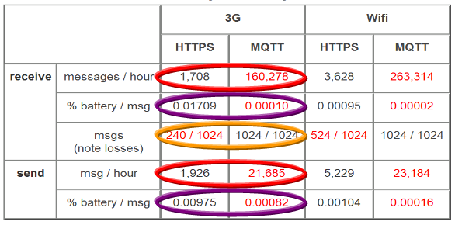
MQTT Messaging Performance Advantage
A message consists of a compressed bit-wise 2 bytes header plus a variable load.
  Smallest load is 0 bytes!
Provides multiple message delivery guarantees
  0 – message delivered at most once
  1 – message will be delivered, but may be duplicated
  2- message will be delivered exactly once.
Remarkable MQTT vs HTTP performance difference, especially throughput. Varies with Delivery Guarantees
http://stephendnicholas.com/archives/1217

Slide 26
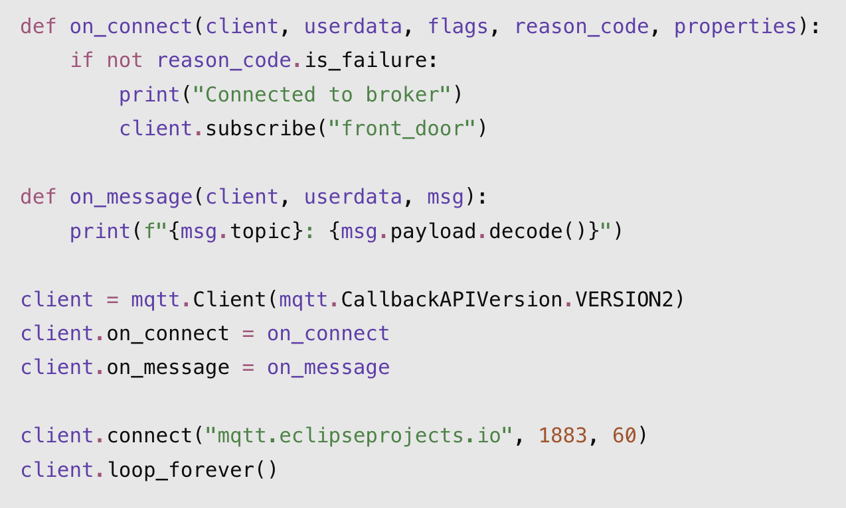
Simple Client Example
MQTT is event-driven. Instead of polling for messages, the application registers callbacks that MQTT invokes when events occur.
on_connect() — Called upon connection to the broker; subscribes to the front_door topic.
on_message() — Called when a matching message arrives; displays its topic and decoded payload.
mqtt.Client() — Creates the MQTT client and registers the two callback functions.
connect() — Connects to the broker using TCP port 1883.
loop_forever() — Runs the event loop, continuously receiving messages and invoking callbacks.

Slide 27
MQTT-SN Variant
MQTT-SN (sensor network) is a variation of MQTT aimed at embedded devices on non-TCP/IP networks, such as Zigbee.
Latest version standardized under the nick name: Oasis (MQTT-SN v2.0 under the OASIS MQTT Technical Committee).
Resources:
http://mqtt.org/
http://www.eclipse.org/community/eclipse_newsletter/2014/february/article2.php

Slide 28
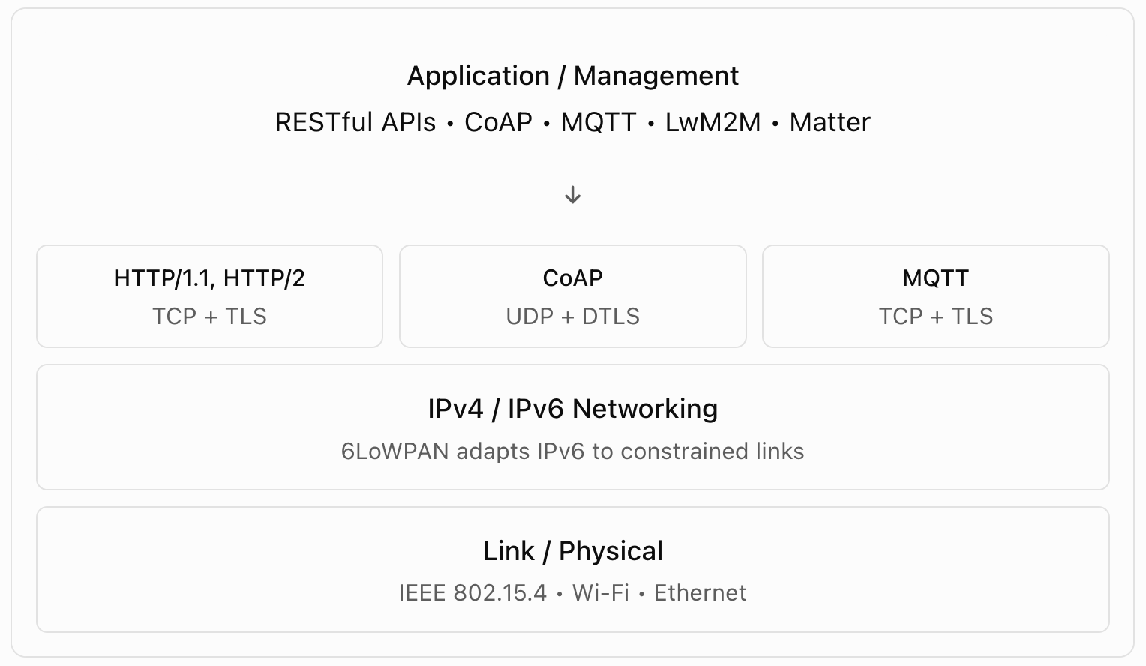
At a Glance Comparison

Slide 29
Detailed Comparison!
Dimension | REST / HTTP | CoAP | MQTT
Transport | TCP | UDP (DTLS); TCP optional | TCP (TLS optional)
Encoding | Text (JSON, XML, HTML) | Binary + text (CBOR, JSON) | Binary header + any payload
Message model | Request/response | Request/response + observe (push) | Publish/subscribe
Addressing | URI per resource | URI per resource | Topic namespace (hierarchical)
Broker needed? | No | No (proxy for HTTP bridge) | Yes
Device role | Client or server | Client and server simultaneously | Publisher, subscriber, or both
Best for | Web-facing APIs, human-readable data (Data Dashboards for IoT) | Constrained devices, P2P, multicast | Fan-out telemetry, event streams, low-power sensors

Slide 30
6LoWPAN
IPv6 based Low Power Wireless Personal Area Network

Slide 31

IPv6 over Low-power Wireless Personal Area Networks
6LoWPAN is an IETF working group that targets enabling small devices to participate in the IoT using IP.
Low-power wireless mesh network where every node has its own IPv6 address, allowing it to connect directly to the Internet using open standards.
Defined mechanisms that allow IPv6 packets to be sent and received over IEEE 802.15.4 based networks like ZigBee.
Why IPv6 is relevant here? Why is it used in 6LoWPAN?

Slide 32
But What is IEEE 802.15.4?
IEEE 802.15.4 is not Wi-Fi. Wi-Fi is defined by a completely
different standard family.
 | IEEE 802.15.4 | Wi-Fi (IEEE 802.11)
Range | ~10–100 m | ~50–100 m indoors
Data rate | 250 kbps | 100 Mbps – several Gbps
Power | Ultra-low (years on a battery) | High (needs mains or frequent charging)
Topology | Mesh, star | Star (access point)
Use case | Sensors, IoT edge devices | Laptops, phones, cameras
Examples | Zigbee, Thread, Matter | 802.11n, 802.11ac, 802.11ax (Wi-Fi 6)

Slide 33
6LoWPAN over Thread for Matter
IEEE 802.15.4 is therefore an ultra low power low bandwidth wireless communication standard for IoT devices.
6LoWPAN is a special low-power routing protocols
6LoWPAN is today the foundation layer of Thread, which is now the networking backbone of Matter, the smart home interoperability standard backed by Apple, Google, Amazon, IKEA, and Samsung.
Thread uses 6LoWPAN over the IEEE 802.15.4 wireless protocol.
Every Thread device has its own IPv6 address, allowing it to connect directly to the internet — something Zigbee does not offer.

Slide 34
Technically, What does 6LoWPAN really do?
The core problem is a size mismatch. IPv6 requires a maximum transmission unit (MTU) of at least 1280 bytes. IEEE 802.15.4's standard packet size is only 127 octets — kept short deliberately to reduce power consumption.
It solves this through three mechanisms:
Header compression — the 6LoWPAN adaptation layer reduces the standard 40-byte IPv6 header to as little as 6–7 bytes through aggressive compression.
Fragmentation and reassembly — large IPv6 packets are split into multiple 802.15.4 frames and reassembled at the destination.
Mesh addressing — devices can relay packets across multiple hops without needing full IP routing at every node.

Slide 35
Open Mobile Alliance Device Management (OMA)
OMA-DM ➔ LwM2M

Slide 36
Role of Device Management
Flashing IoT things and maintaining firmware updates will be a critical aspect of the IoT
Device management standards have gained “value” status lately especially to the rise of the smartphone industry.
OMA-DM (Device Management) standard was launched for mobile devices back in 2008 and 2013. Today, Microsoft extended it to its own enterprise Mobile Device Management (MDM) called MMP-C. And Apple also built its own MDM inspired by OMA-DM.

Slide 37
(OMA-DM)
The OMA DM specifications define the protocols and the mechanisms allowing an OMA DM Server to deliver configuration parameters to an OMA DM Client, by using a defined set of “DM Commands” for various management procedures to be executed inside a well-defined and secure environment (the “DM Session”).

Slide 38
(OMA-DM)
The OMA DM Client exposes the device internal data to the OMA DM Server in the form of a hierarchic tree known as the “DM Tree”: it is made up of different building blocks (or sub-trees) called Management Objects providing specific functionality in the management of devices.
The management and updates of a device feature amounts to the management of a node in its DM Tree.

Slide 39
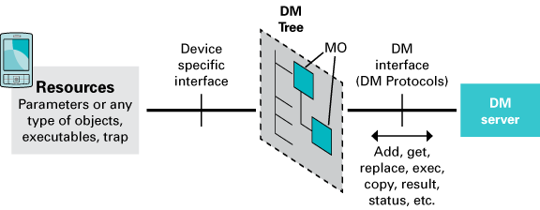
(OMA-DM)

Slide 40
OMA-DM Capabilities
Software Management (OMA DM SCOMO) allowing not only the installation and the removal of applications on the mobile, but also the retrieval of the inventory of software components already installed on the device
Diagnostics and Monitoring (OMA DM DiagMon MO), which enables remote diagnostic, for example to query the device for memory and battery status or to collect radio measures and QoS parameters, and remote monitoring, by defining trap and reports
Connectivity (OMA DM ConnMO), which allows the configuration of bearers and proxies
Device Capabilities (OMA DM DCMO), which allows a Management Authority to remotely enable and disable device peripherals like cameras, Bluetooth, USB, etc.

Slide 41
OMA-DM Capabilities, Cont’d
Lock and Wipe (OMA DM LAWMO), which allows to remotely lock and/or wipe the device, for instance when the device is stolen or sold, or when personal or enterprise data are compromised
Browser (OMA DM BMO), which allows remote management of browser favorites and settings
Virtualization (OMA DM VirMO), which enables remote management of virtual machines running on the device (expected for 3Q 2013)
Management Policy (OMA DM Management Policy MO), which allows the deployment on the device of policies which the DM Client can execute and enforce independently: if some events happen, then perform some operations (expected for 2Q 2014)

Slide 42
LwM2M: Light Weight Machine To Machine
OMA-DM solved device management for smartphones — but smartphones have processors, memory, and always-on power. IoT devices do not.
LwM2M is OMA's IoT-native answer: same problem domain (remote device management, configuration, firmware update), redesigned from scratch for constrained devices.
Runs over CoAP + DTLS over UDP — the same stack we just learned. This is not a coincidence: CoAP's binary encoding and UDP's low overhead are what makes LwM2M viable on a microcontroller.
Current version (actively maintained): LwM2M 1.2 (2023).
Notice, LwM2M is not a replacement for MQTT or CoAP — it sits on top of CoAP. MQTT/CoAP to manage the IoT devices, or their edges

Slide 43
How LwM2M structures device information
The entire state of a device is expressed as a tree of numbered Objects, each containing numbered Resources. This is the spiritual successor to the OMA-DM Tree — but binary and compact instead of XML.
Every object has a standardized ID registered with OMNA (OMA's registry). Key ones are shown in the table.
Object ID | Name | What it does
/1 | LwM2M Server | Broker address, lifetime, binding mode
/3 | Device | Manufacturer, model, serial number, reboot
/4 | Connectivity Monitoring | Signal strength, IP address, network bearer
/5 | Firmware Update | The OTA object — download URI, update trigger, state machine
/6 | Location | GPS latitude, longitude, altitude
/3303 | Temperature | Sensor value, units, min/max measured

Slide 44
Example: Reading a device's serial number
To read a device's serial number, the server issues a CoAP GET to:
coap://device.example.com/3/0/2
└── Object 3 (Device)
└── Instance 0
└── Resource 2 (Serial Number)

Slide 45
OTA firmware update: the /5 state machine
The Firmware Update Object (/5) defines a standardized four-step state machine.
Server writes firmware URI to Resource /5/0/1 — the device fetches the binary via CoAP block transfer (or HTTPS pull).
Device reports state = Downloaded and validates integrity (hash check). If it fails, state returns to Idle with an error code.
Server executes Resource /5/0/2 (Update trigger) — the device writes the new firmware to flash and reboots.
Device reports result on reconnect: 1 = success, 2 = insufficient flash, 3 = out of RAM, 4 = connection lost, 5 = CRC failure, 6 = unsupported package type, 7 = invalid URI. Server can rollback if needed.
What happens if power is lost mid-flash? How should a well-designed IoT bootloader handle this — and what role does LwM2M's state machine play in recovery?

